Slide 1

KICKING THE
TIRES OF
GOOGLE APP
ENGINE
ROB SPECTRE
@dN0t

Slide 2
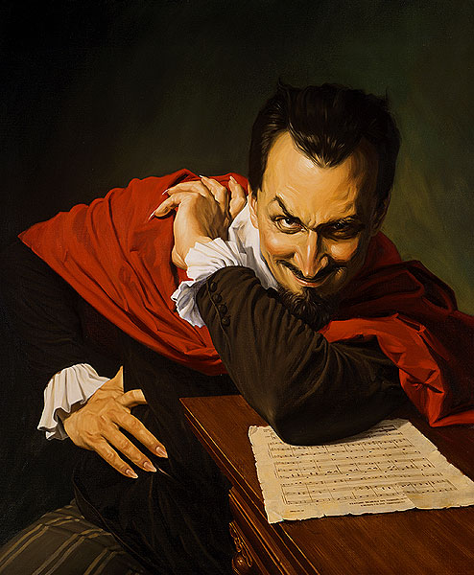
I WANT TO MAKE
A DEAL

Slide 3

I WANT TO MAKE
MAKE YOU FAST

Slide 4
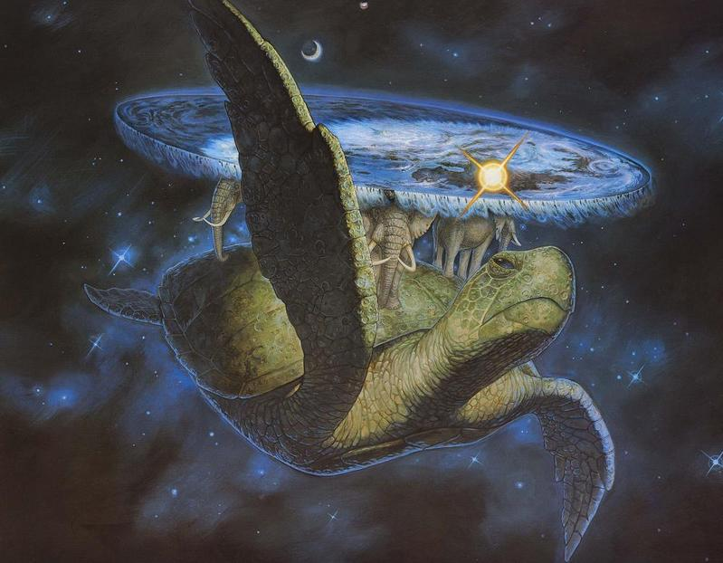
I WANT TO MAKE
MAKE YOU SCALABLE

Slide 5
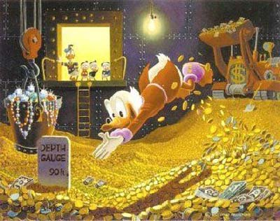
I WANT TO MAKE
MAKE YOU RICH

Slide 6

AND I WON'T CHARGE
YOU A THING

Slide 7
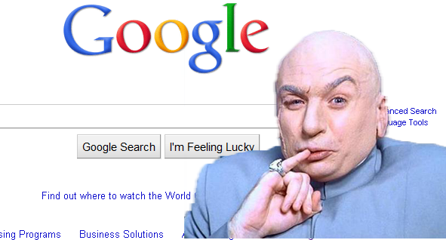
WHAT'S MY NAME?
SINCE YOU ASKED

Slide 8
MAKE A DEAL WITH
GOOGLE APP ENGINE

Slide 9
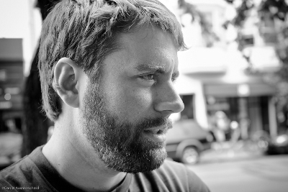
OH HAI
I IS ROB

Slide 10
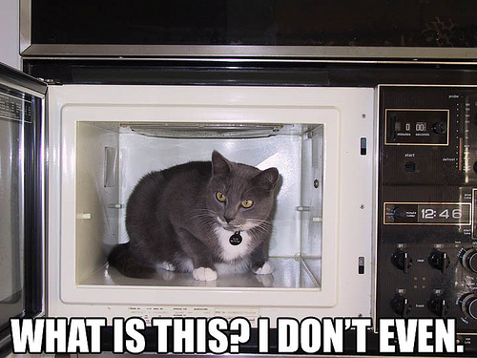
MY CAT MICROWAVE
LET ME SHOW YOU IT

Slide 11

ID4 JOKES DON'T WORK
WITH THIS CROWD, ROB

Slide 12

YOU THINK FINAL FANTASY
WILL WORK ANY BETTER?

Slide 13
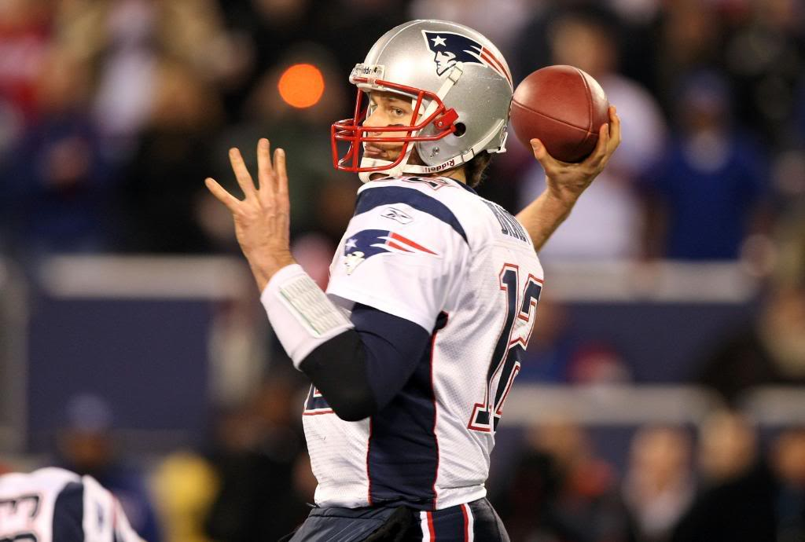
THEY <3 TOM BRADY
IN PHILADELPHIA

Slide 14

CHOOSE
WISELY

Slide 15
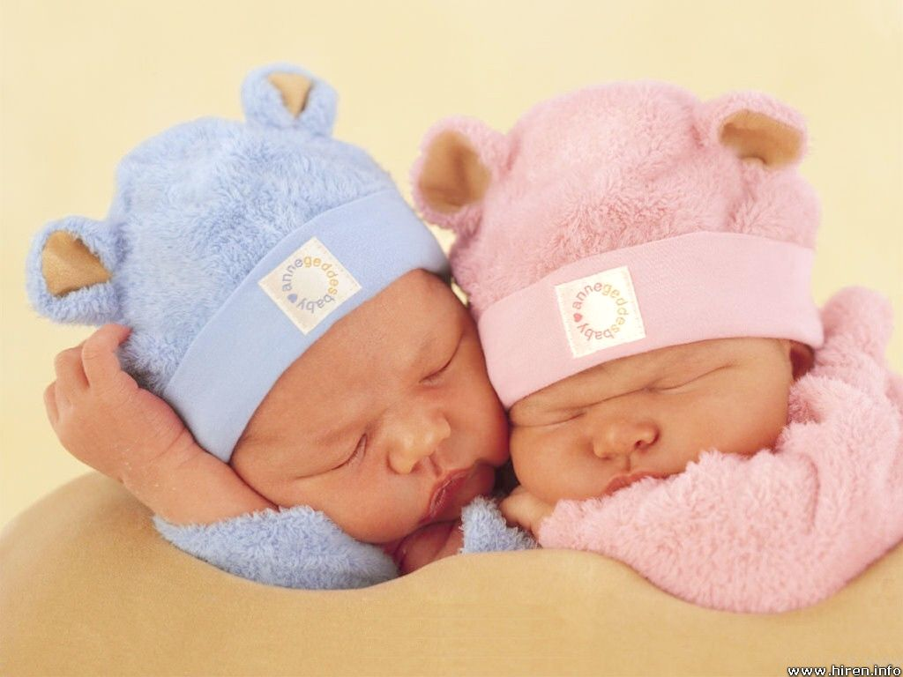
MAYBE BABIES WILL SAVE
ME FROM THIS CROWD

Slide 16
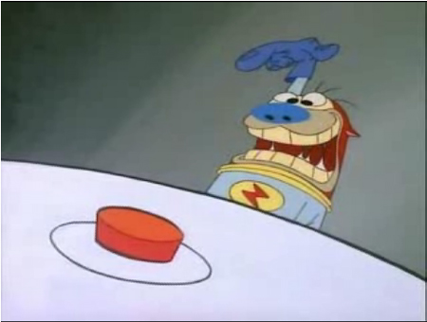
BUTTONS
WANT TO BE PRESSED

Slide 17

WINCE BEFORE THIS
TERRIBLE PUN

Slide 18

PUNS ARE BETTER IN
PAIRS

Slide 19
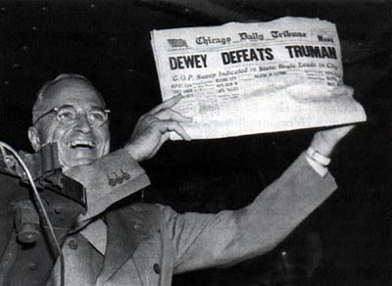
RUNNING OUT OF GAS
WITH THE PUNS

Slide 20
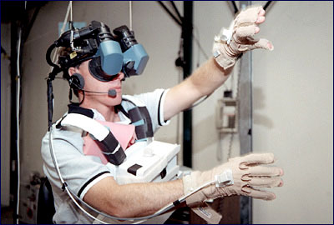
IS THIS GUY PLAYING
A KAYAKING GAME?

Slide 21
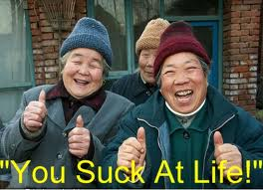
I SUCK AT POWERPOINT
LETS LOOK AT EXAMPLES

Slide 22
USERS ARE EASY
(THAT'S WHAT SHE...)
from google.appengine.api import users
from google.appengine.ext import webapp
from google.appengine.ext.webapp.util import run_wsgi_app
class MainPage(webapp.RequestHandler):
def get(self):
user = users.get_current_user()
if user:
self.response.headers['Content-Type'] = 'text/plain'
self.response.out.write('Hello, ' + user.nickname())
else:
self.redirect(users.create_login_url(self.request.uri))

Slide 23
OAUTH IS EASIER
(THAT'S WHAT HE...)
from google.appengine.api import oauth
# ...
try:
# Get the db.User that represents the user on whose behalf the
# consumer is making this request.
user = oauth.get_current_user()
except oauth.OAuthRequestError, e:
# The request was not a valid OAuth request.
# ...

Slide 24
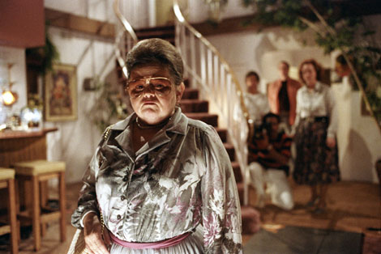
CHANNELING
SERIOUS BUSINESS

Slide 25

THIS DUDE HAS GONE
FROM NERD TO DORK

Slide 26

CAVEAT
EMPTOR

Slide 27
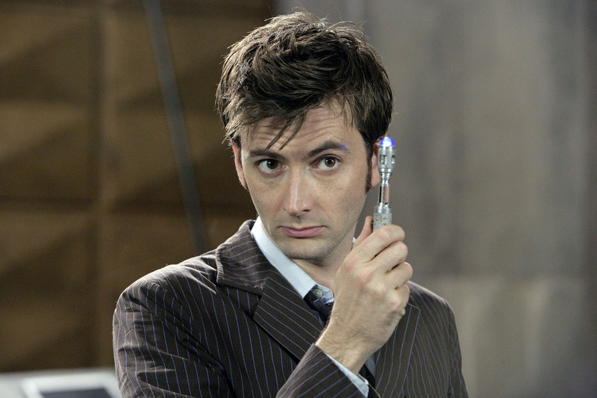
I <3 <3
DOCTOR WHO

Slide 28
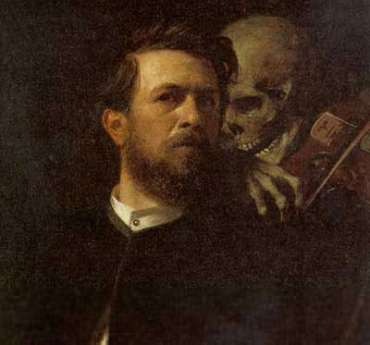
SOMETIMES IT JUST
ISN'T THAT SERIOUS

Slide 29
GITHUB.COM/RobSpectre/Talks
@dN0t
RSPECTRE @TWILIO.COM
BROOKLYNHACKER.COM

Slide 30
THANK
YOU!

